Slide 1
UX /UI

Slide 2
inspiracje
https://www.carbondesignsystem.com/tutorial/react-step-3

Slide 3
Form Variation

Slide 4
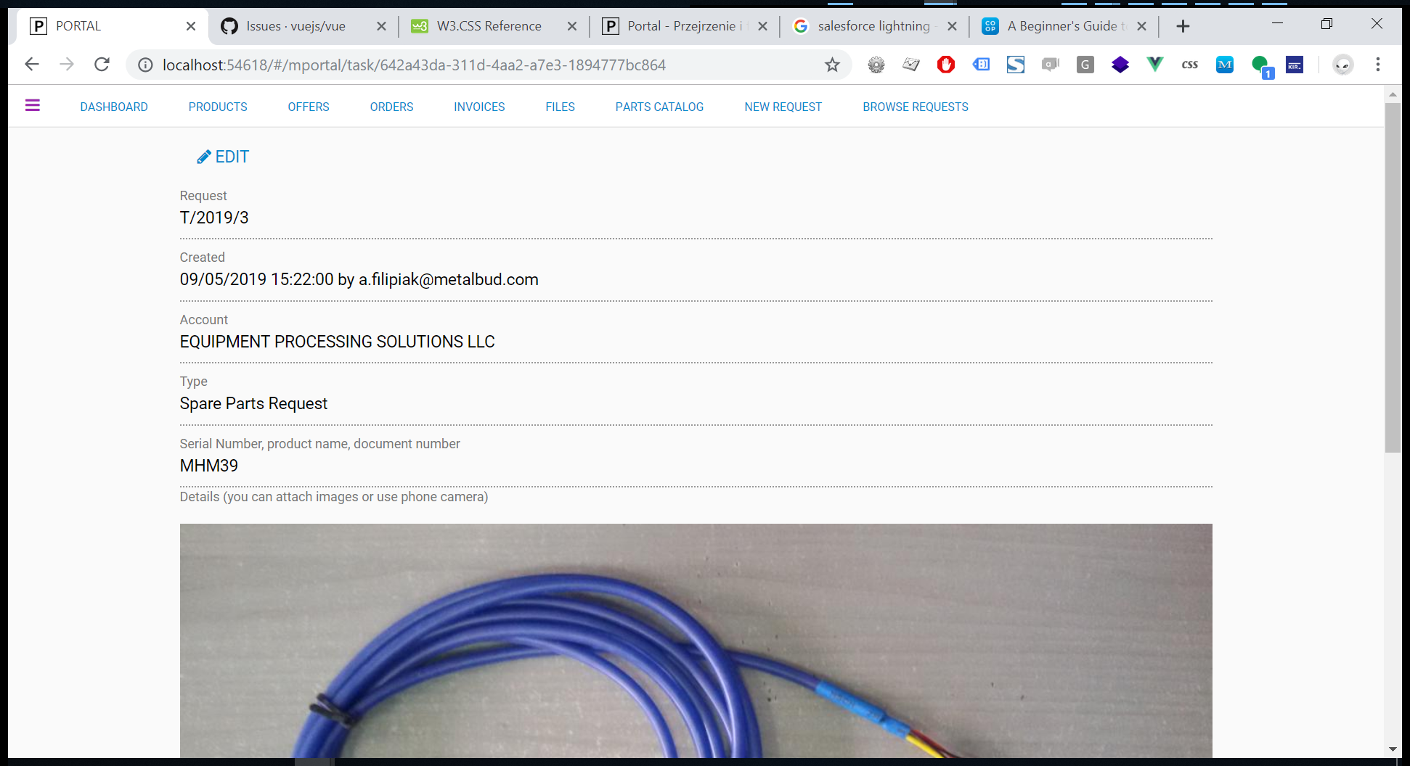

Slide 5
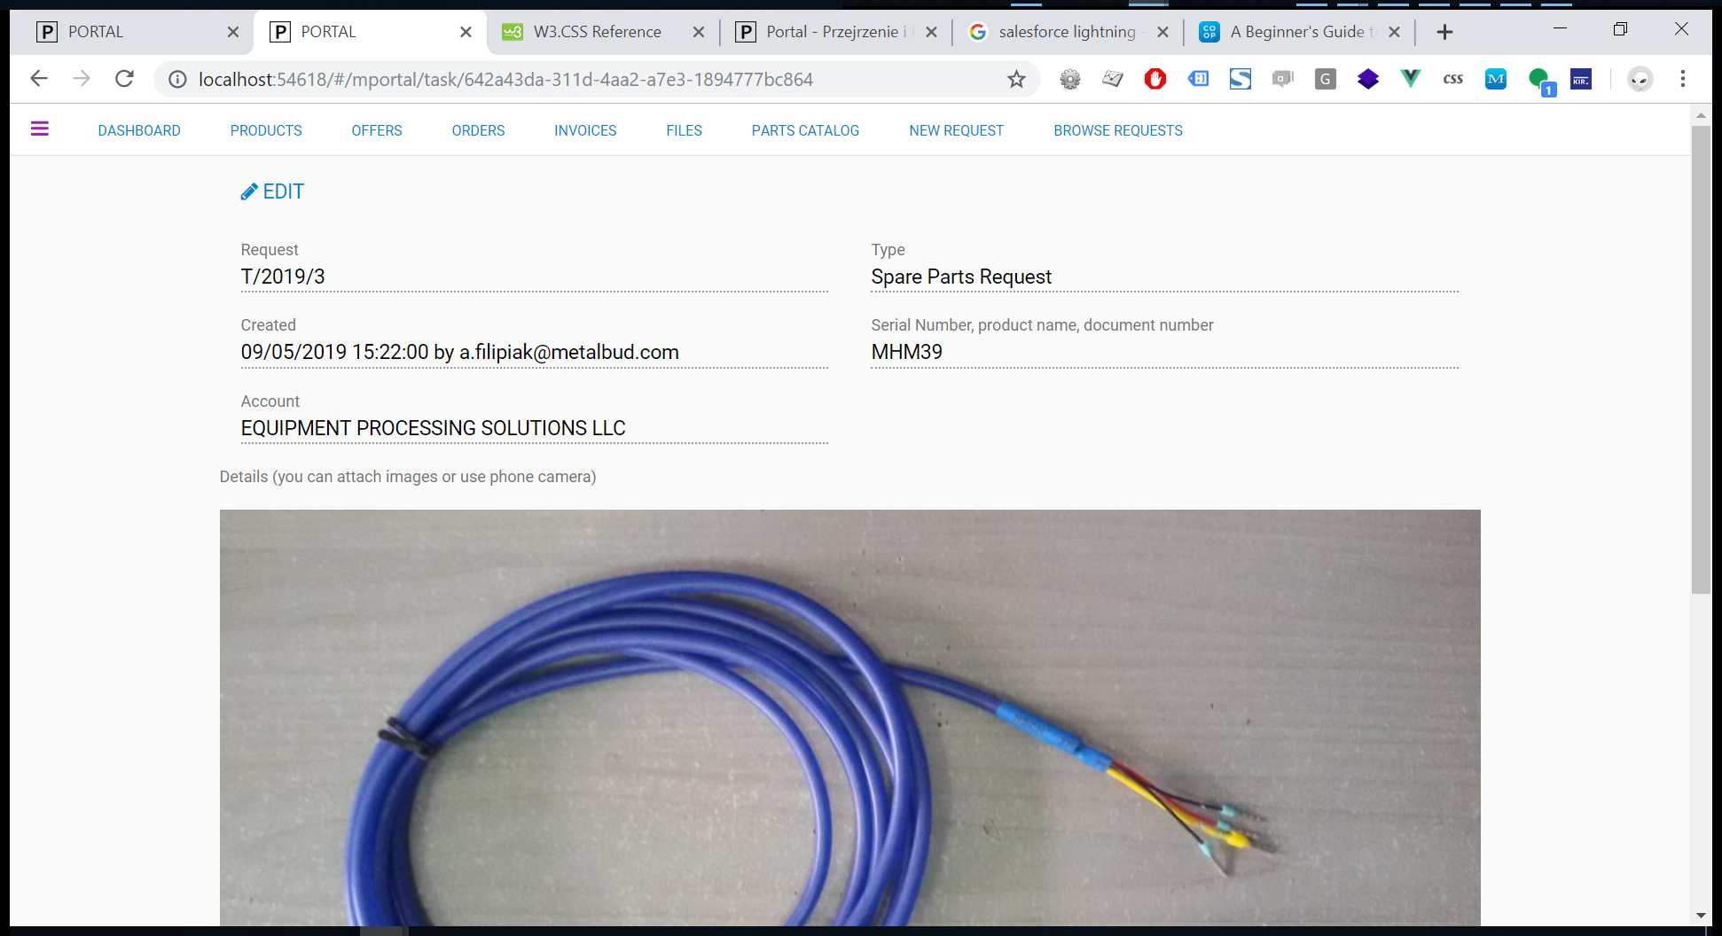
Notes:
//Task na potrzeby metalbudu
Vue.component('v_task_mportal', {
template: `
<div class="w3-content w3-padding">
<div>
<a v-if="api.mode!='write'" @click="api.mode='write'" class=" w3-button w3-bar-item"><i class="fa fa-pencil" aria-hidden="true"></i> EDIT</a>
<a v-if="api.mode=='write'" class="w3-button w3-green w3-bar-item" @click="submit">Save</a>
<a v-if="api.mode=='write'" @click="api.mode = 'read'" class="w3-button w3-red w3-bar-item" >Cancel</a>
</div>
<!-- <router-link v-if="api.mode!='write' && $root.sys.profile['http://schemas.microsoft.com/ws/2008/06/identity/claims/role'].indexOf('sys_administrator') > -1" :to="{ path: '/srs/238/view' ,query: {token : api.model.task_uuid} }"
class=" w3-button w3-light-grey w3-border">Resources (Estimate:{{api.model.estimate}} / Spent:{{api.model.task_time_spent}}m)</router-link> -->
<form @submit.prevent="submit">
<input type="hidden" class="w3-input " v-model="api.model.task_uuid" />
<div class="w3-row">
<div class="w3-col l6">
<div class="p-border-bottom-dots w3-margin">
<div class="w3-text-grey w3-small">Request</div>
<div >{{api.model.task_nr}}</div>
</div>
<div class="p-border-bottom-dots w3-margin" v-if="api.model.task_created_by">
<div class="w3-text-grey w3-small ">Created</div>
<div >{{api.model.task_created_at | formatDateLong }} by {{api.model.task_created_by}}
<span v-if ="api.model.task_resolved_at" class="w3-tag w3-light-grey">Resolved at {{api.model.task_resolved_at | formatDateLong }}</span>
</div>
</div>
<div class="p-border-bottom-dots w3-margin">
<div class="w3-text-grey w3-small">Account</div>
<div >
<select v-if="api.mode=='write'" class="w3-input" v-model="api.model.team_id" required>
<template v-for="item in api.team">
<option :value="item.team_id">
{{item.team_name}}
</option>
</template>
</select>
<div v-else >{{api.model.team_name}}</div>
</div>
</div>
</div>
<div class="w3-col l6">
<div class="p-border-bottom-dots w3-margin">
<div class="w3-text-grey w3-small">Type</div>
<div >
<select v-if="api.mode=='write'" class="w3-input" v-model="api.model.type_id" required>
<template v-for="item in api.type">
<option :value="item.type_id">
{{item.type_name}}
</option>
</template>
</select>
<span v-else >{{api.model.type_name}}</span>
</div>
</div>
<div class="p-border-bottom-dots w3-margin">
<div class="w3-text-grey w3-small">Serial Number, product name, document number</div>
<div >
<input v-if="api.mode=='write'" type="text" class="w3-input" required v-model="api.model.task_name" />
<div v-else >{{api.model.task_name}}</div>
</div>
</div>
</div>
</div>
</form>
<div>
<div class="w3-text-grey w3-small">Details (you can attach images or use phone camera)</div>
<v_textarea v-if="api.mode=='write'" v-model="api.model.task_description" ></v_textarea>
<div v-else v-html="api.model.task_description_html"></div>
</div>
</div>
`
, data: function () {
return {
api: [],
showModal: false
};
},
methods: {
submit: function () {
var link = this.$root.sys.api + '/api/tasks';
var dataPack = this.api.model;
$.ajax({
url: link,// this.endPoint,
context: this,
method: 'POST',
data: JSON.stringify(dataPack),
contentType: "application/json",
success: function (data) {
if (this.$router.currentRoute.params.id != this.api.model.task_uuid)
router.push({ path: '/mportal/task/' + this.api.model.task_uuid }); // this.$root.fetchData(); - funkcje ta przejal watch:{ na app{}
this.api.mode = 'read'
this.fetchData();
notifications(data);
//this.showModal = false;
//this.$emit('update');
// this.preview = data;
},
error: function (data) {
notifications(data);
}
});
}
,
reset: function () {
model.name = '';
model.input = '';
},
fetchData: function fetchData() {
//if (pageoffset !== undefined) {
// if (this.api.page + pageoffset > 0) {
// this.api.page = this.api.page + pageoffset;
// }
//}
logger.log(this.$router.currentRoute);
// if (this.$refs.query)
// this.$nextTick(() => this.$refs.query.focus())
this.$root.sys.error = '';
var link = this.$root.sys.api + '/api/tasks/' + this.$router.currentRoute.params.id;
var dataPack;
if (this.api.parameters) {
dataPack = {
parameters: JSON.stringify(this.api.parameters)
};
}
return $.ajax({
url: link, // this.endPoint,
context: this,
method: 'GET',
data: dataPack,
contentType: "application/json",
success: function success(data) {
//bindowanie
this.api = data;
if (this.$route.path.endsWith("/new"))
{
this.api.model.task_name = this.$route.query.task_name;
this.api.model.task_remote_id = this.$route.query.task_remote_id;
this.api.model.task_remote_source = this.$route.query.task_remote_source;
}
},
error: function error(data) {
notifications(data);
}
});
}
}
, watch: {
'$route': function $route(to, from) {
this.fetchData(true);
}
}, filters: {
}
, created() {
////try to get id
//this.model.remote_id = undefined;
//this.model.remote_source = this.$router.currentRoute.params.component;
//if (!this.model.remote_id) // some_variable is either null, undefined, 0, NaN, false, or an empty string
// this.model.remote_id = this.$router.currentRoute.query.id;
//if (!this.model.remote_id)
// this.model.remote_id = this.$router.currentRoute.query.token;
//if (!this.model.remote_id)
// this.model.remote_id = this.$router.currentRoute.params.param1;
//if (!this.model.remote_source)
// this.model.remote_source = this.$router.currentRoute.query.source;
// this.reset();
},
mounted: function mounted() {
this.fetchData(true);
}
});

Slide 6
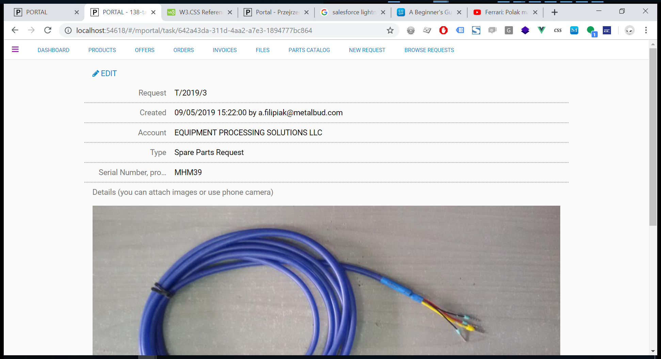
Notes:
//Task na potrzeby metalbudu
Vue.component('v_task_mportal', {
template: `
<div class="w3-content w3-padding">
<div>
<a v-if="api.mode!='write'" @click="api.mode='write'" class=" w3-button w3-bar-item"><i class="fa fa-pencil" aria-hidden="true"></i> EDIT</a>
<a v-if="api.mode=='write'" @click="submit" class="w3-button w3-green w3-bar-item">Save</a>
<a v-if="api.mode=='write'" @click="api.mode = 'read'" class="w3-button w3-red w3-bar-item" >Cancel</a>
</div>
<!-- <router-link v-if="api.mode!='write' && $root.sys.profile['http://schemas.microsoft.com/ws/2008/06/identity/claims/role'].indexOf('sys_administrator') > -1" :to="{ path: '/srs/238/view' ,query: {token : api.model.task_uuid} }"
class=" w3-button w3-light-grey w3-border">Resources (Estimate:{{api.model.estimate}} / Spent:{{api.model.task_time_spent}}m)</router-link> -->
<form @submit.prevent="submit">
<input type="hidden" class="w3-input " v-model="api.model.task_uuid" />
<div class="p-border-bottom-dots w3-row-padding w3-padding">
<label class="w3-text-grey w3-col l2 w3-right-align">Request</label>
<div class="w3-col l10 ">{{api.model.task_nr}}</div>
</div>
<div class="p-border-bottom-dots w3-row-padding w3-padding" v-if="api.model.task_created_by">
<label class="w3-text-grey w3-col l2 w3-right-align">Created</label>
<div class=" w3-col l10">{{api.model.task_created_at | formatDateLong }} by {{api.model.task_created_by}}
<span v-if ="api.model.task_resolved_at" class="w3-tag w3-light-grey">Resolved at {{api.model.task_resolved_at | formatDateLong }}</span>
</div>
</div>
<div class="p-border-bottom-dots w3-row-padding w3-padding">
<label class="w3-text-grey w3-col l2 w3-right-align">Account</label>
<div class=" w3-col l10" >
<select v-if="api.mode=='write'" class="w3-input" v-model="api.model.team_id" required>
<template v-for="item in api.team">
<option :value="item.team_id">
{{item.team_name}}
</option>
</template>
</select>
<span v-else >{{api.model.team_name}}</span>
</div>
</div>
<div class="p-border-bottom-dots w3-row-padding w3-padding">
<label class="w3-text-grey w3-col l2 w3-right-align">Type</label>
<div class=" w3-col l10" >
<select v-if="api.mode=='write'" class="w3-input" v-model="api.model.type_id" required>
<template v-for="item in api.type">
<option :value="item.type_id">
{{item.type_name}}
</option>
</template>
</select>
<span v-else >{{api.model.type_name}}</span>
</div>
</div>
<div class="p-border-bottom-dots w3-row-padding w3-padding">
<label class="w3-text-grey w3-col l2 w3-right-align p-line" title="Serial Number, product name, document number">Serial Number, product name, document number</label>
<div class=" w3-col l10" >
<input v-if="api.mode=='write'" type="text" class="w3-input" required v-model="api.model.task_name" />
<div v-else >{{api.model.task_name}}</div>
</div>
</div>
<div class="p-border-bottom-dots w3-padding">
<label class="w3-text-grey">Details (you can attach images or use phone camera)</label>
<v_textarea v-if="api.mode=='write'" v-model="api.model.task_description" ></v_textarea>
<div v-else v-html="api.model.task_description_html"></div>
</div>
</form>
</div>
`
, data: function () {
return {
api: [],
showModal: false
};
},
methods: {
submit: function () {
var link = this.$root.sys.api + '/api/tasks';
var dataPack = this.api.model;
$.ajax({
url: link,// this.endPoint,
context: this,
method: 'POST',
data: JSON.stringify(dataPack),
contentType: "application/json",
success: function (data) {
if (this.$router.currentRoute.params.id != this.api.model.task_uuid)
router.push({ path: '/mportal/task/' + this.api.model.task_uuid }); // this.$root.fetchData(); - funkcje ta przejal watch:{ na app{}
this.api.mode = 'read'
this.fetchData();
notifications(data);
//this.showModal = false;
//this.$emit('update');
// this.preview = data;
},
error: function (data) {
notifications(data);
}
});
}
,
reset: function () {
model.name = '';
model.input = '';
},
fetchData: function fetchData() {
//if (pageoffset !== undefined) {
// if (this.api.page + pageoffset > 0) {
// this.api.page = this.api.page + pageoffset;
// }
//}
logger.log(this.$router.currentRoute);
// if (this.$refs.query)
// this.$nextTick(() => this.$refs.query.focus())
this.$root.sys.error = '';
var link = this.$root.sys.api + '/api/tasks/' + this.$router.currentRoute.params.id;
var dataPack;
if (this.api.parameters) {
dataPack = {
parameters: JSON.stringify(this.api.parameters)
};
}
return $.ajax({
url: link, // this.endPoint,
context: this,
method: 'GET',
data: dataPack,
contentType: "application/json",
success: function success(data) {
//bindowanie
this.api = data;
if (this.$route.path.endsWith("/new")) {
this.api.model.task_name = this.$route.query.task_name;
this.api.model.task_remote_id = this.$route.query.task_remote_id;
this.api.model.task_remote_source = this.$route.query.task_remote_source;
}
},
error: function error(data) {
notifications(data);
}
});
}
}
, watch: {
'$route': function $route(to, from) {
this.fetchData(true);
}
}, filters: {
}
, created() {
////try to get id
//this.model.remote_id = undefined;
//this.model.remote_source = this.$router.currentRoute.params.component;
//if (!this.model.remote_id) // some_variable is either null, undefined, 0, NaN, false, or an empty string
// this.model.remote_id = this.$router.currentRoute.query.id;
//if (!this.model.remote_id)
// this.model.remote_id = this.$router.currentRoute.query.token;
//if (!this.model.remote_id)
// this.model.remote_id = this.$router.currentRoute.params.param1;
//if (!this.model.remote_source)
// this.model.remote_source = this.$router.currentRoute.query.source;
// this.reset();
},
mounted: function mounted() {
this.fetchData(true);
}
});

Slide 7
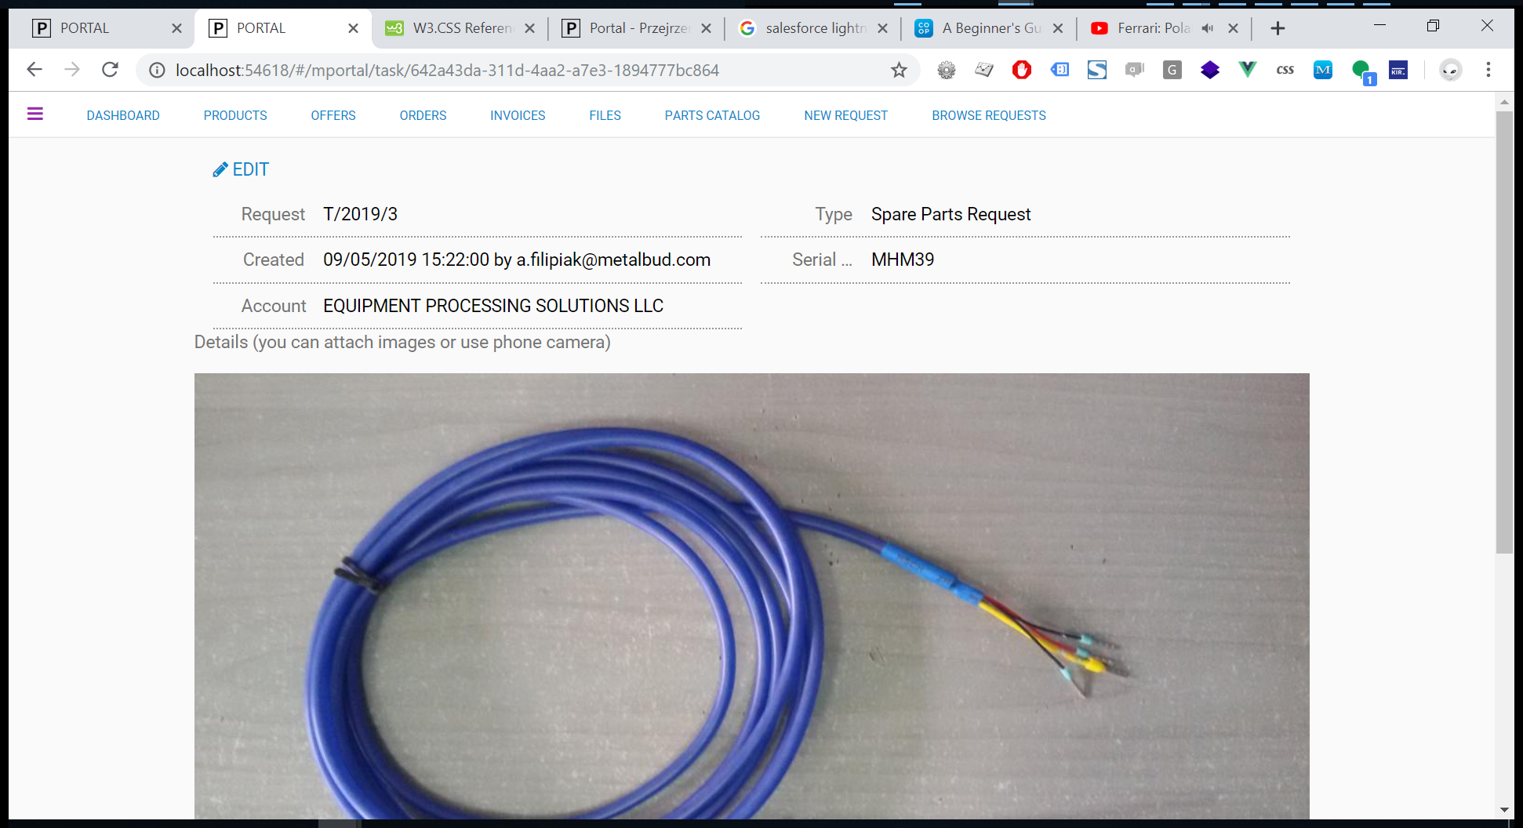

Slide 8
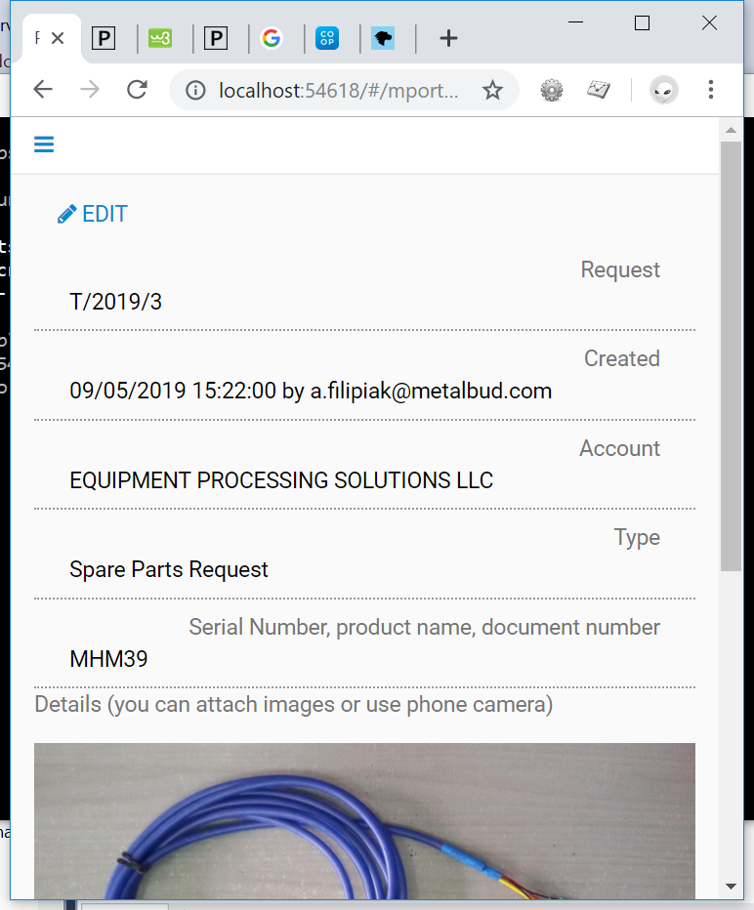

Slide 9
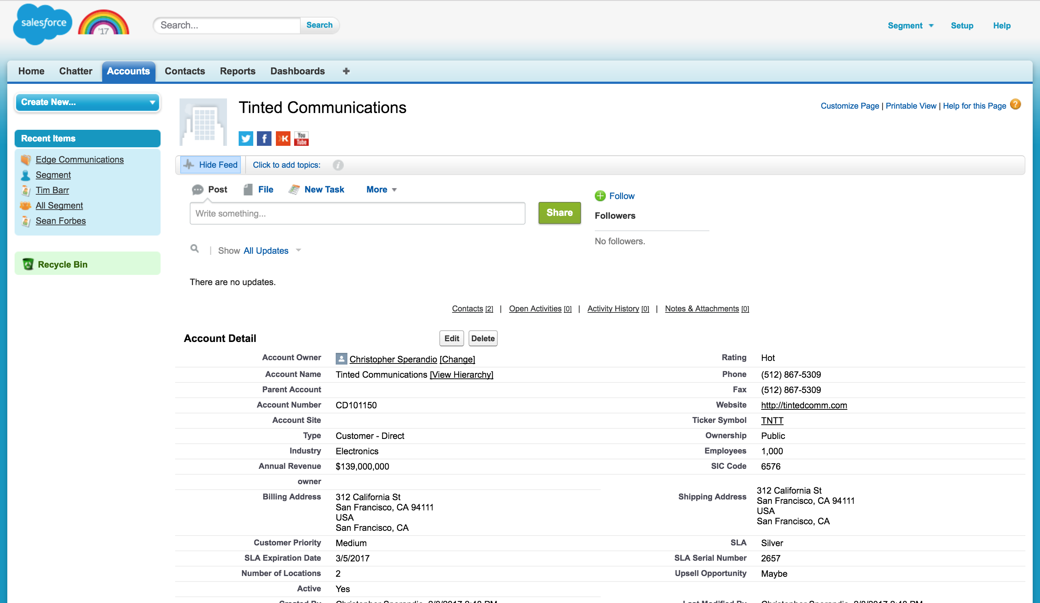

Slide 10
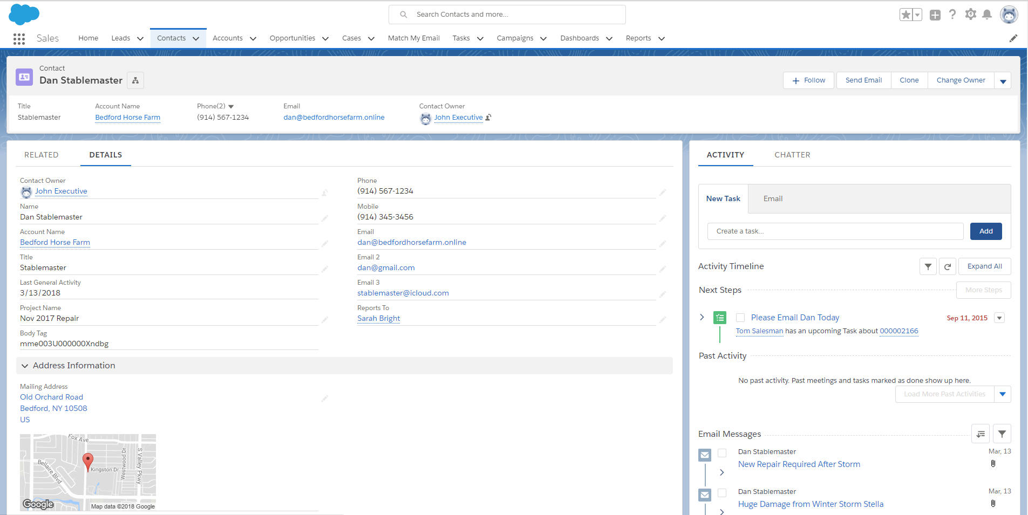

Slide 11
zaawansowany

Slide 12
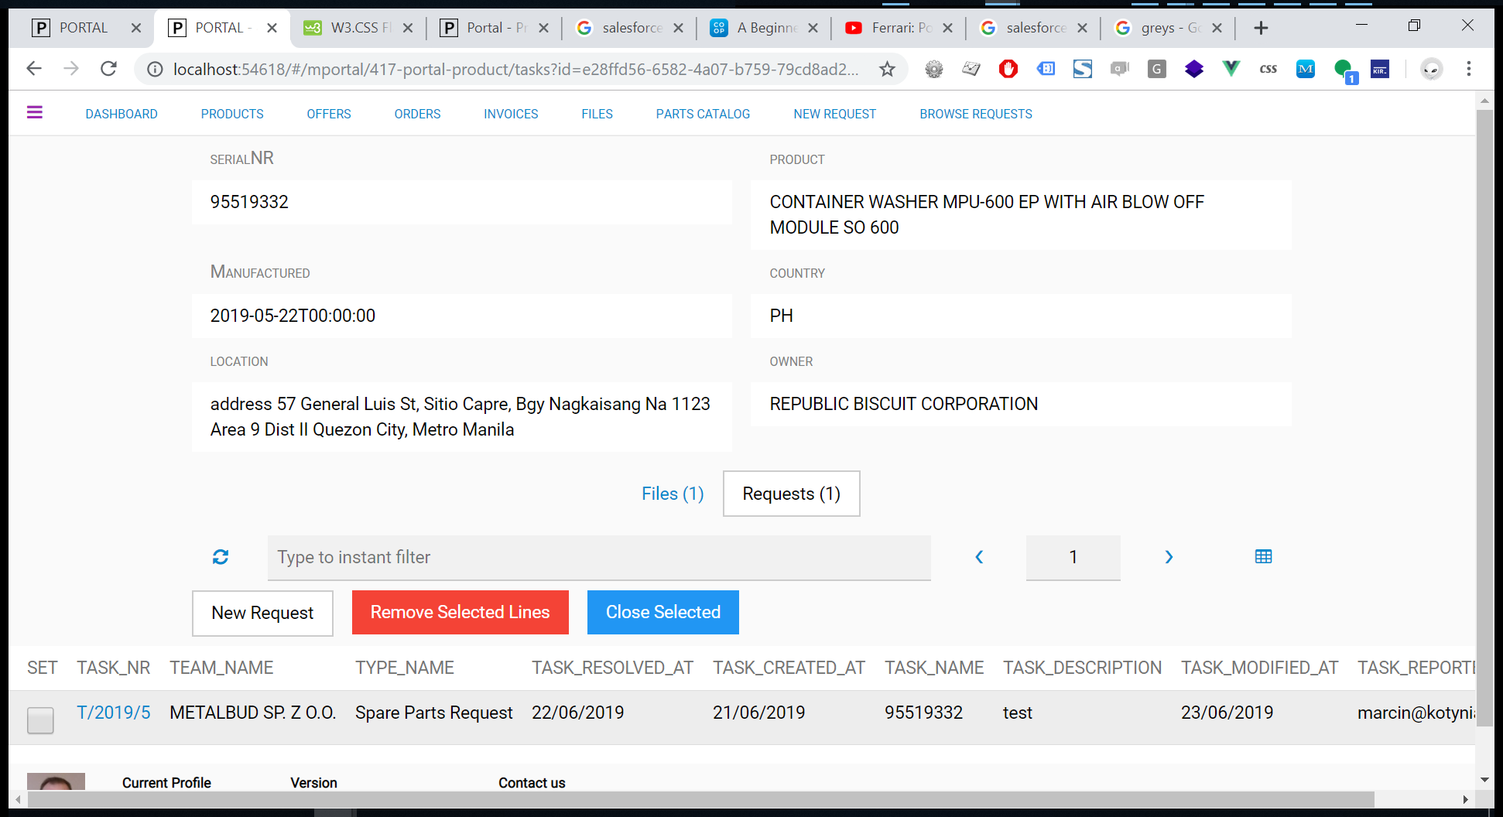

Slide 13
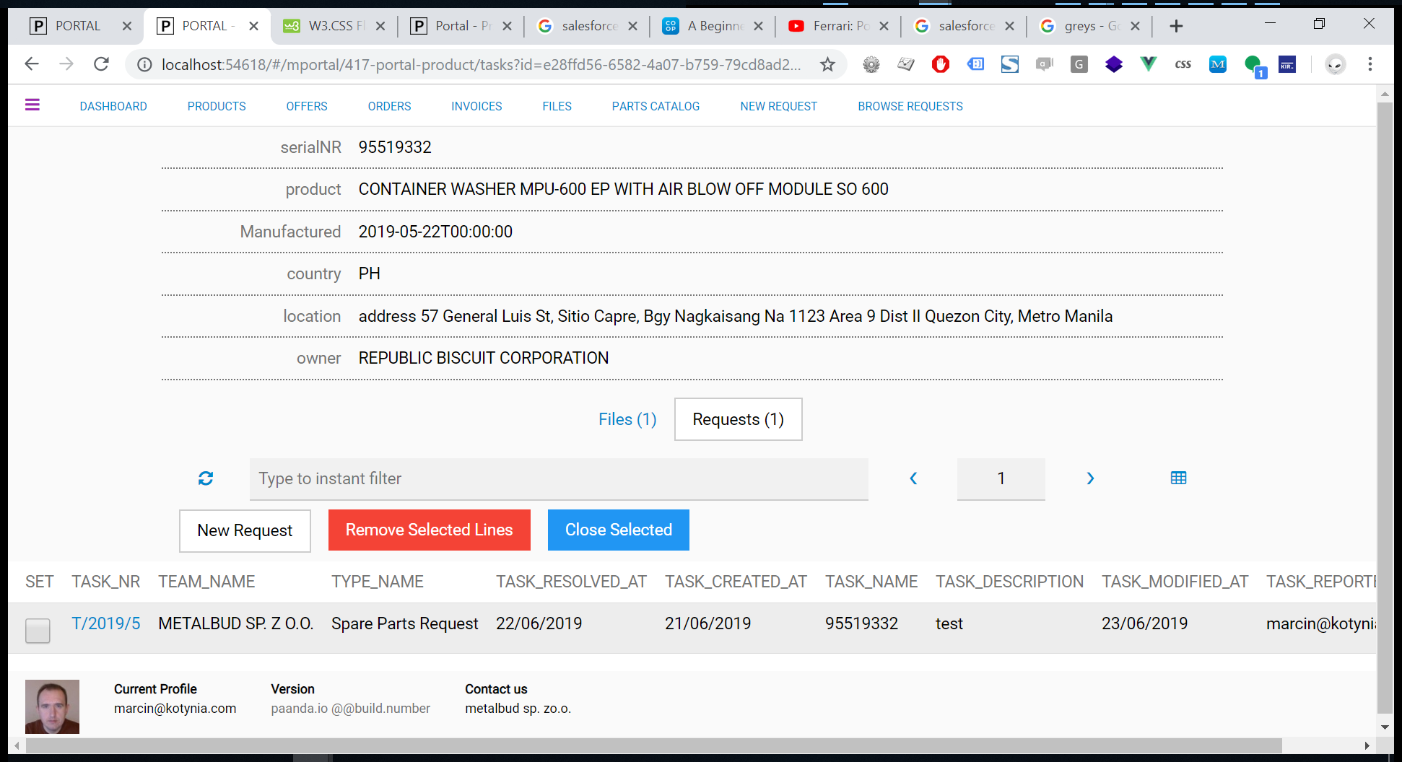

Slide 14
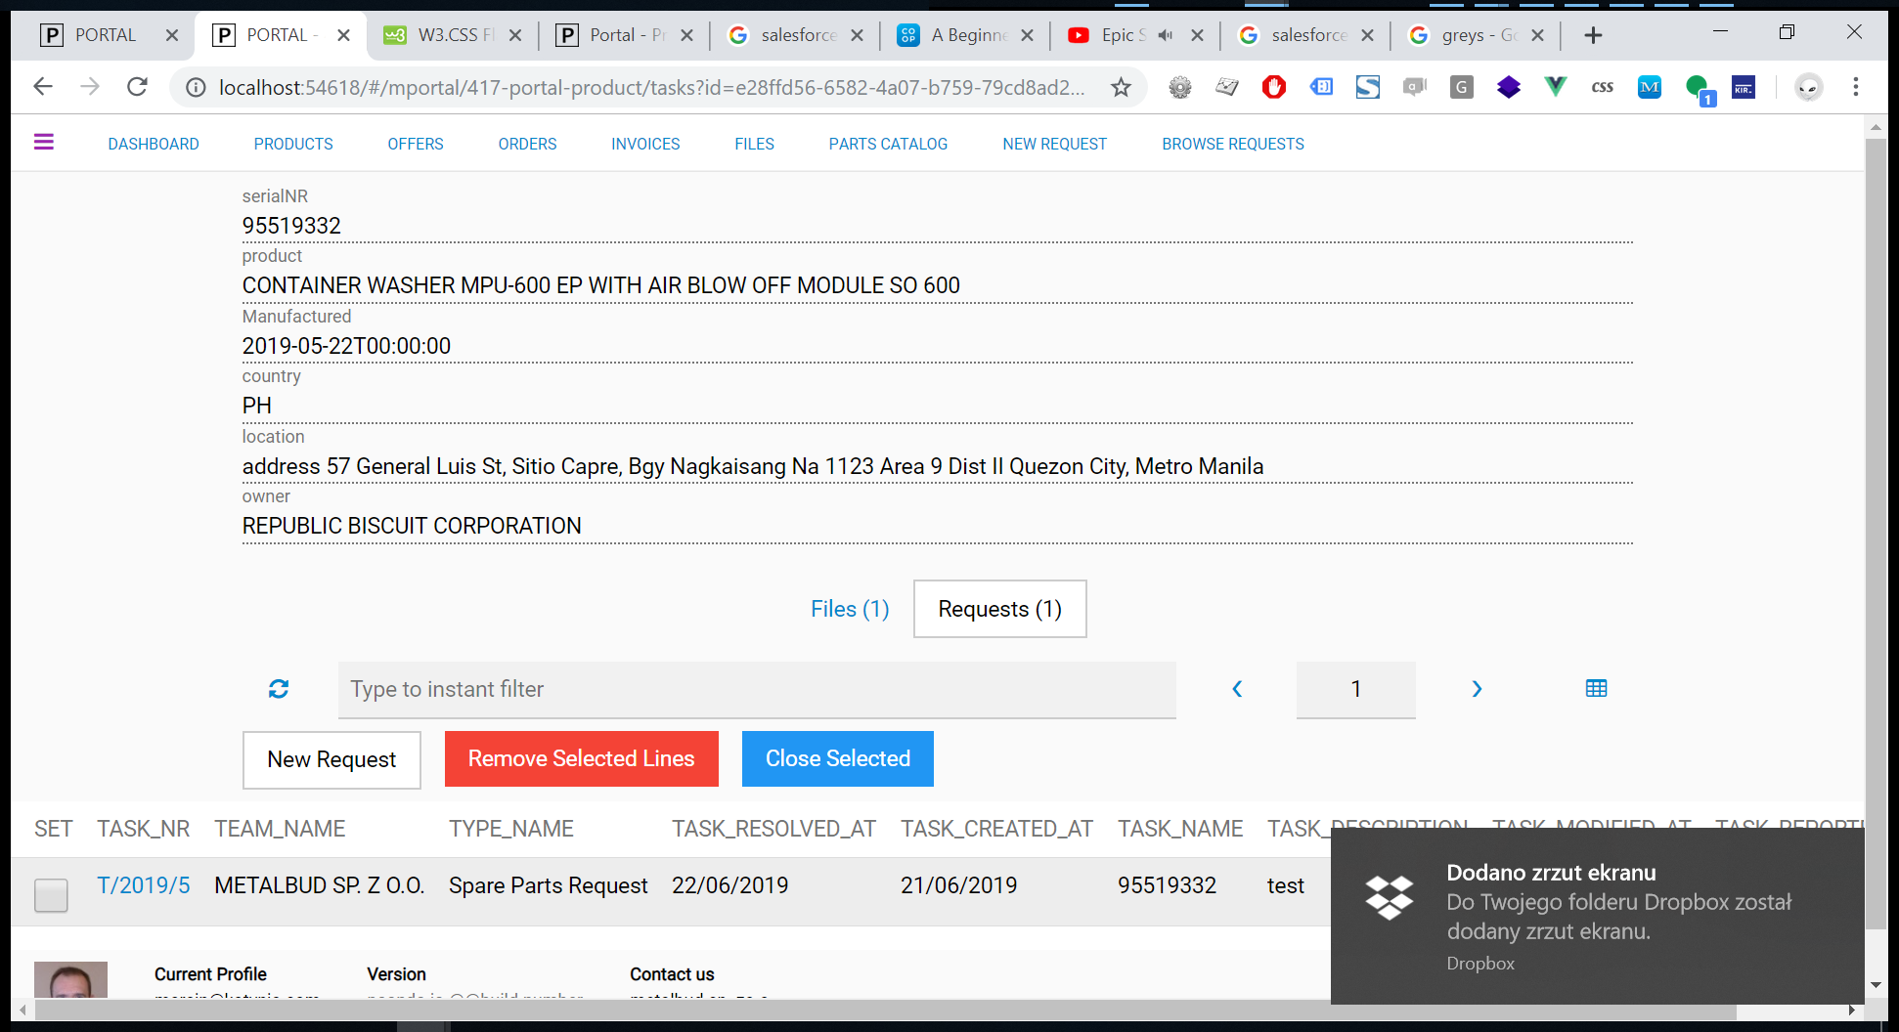

Slide 15
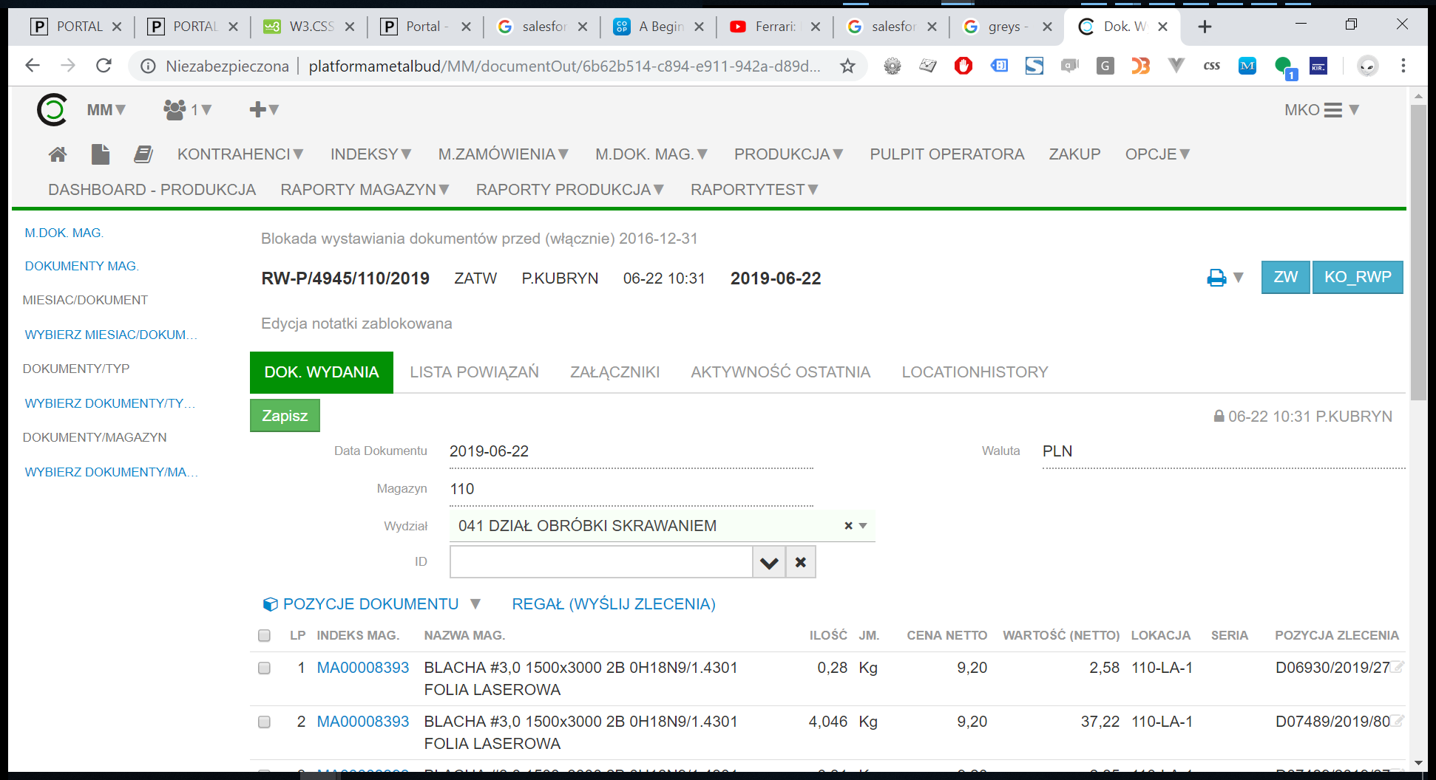

Slide 16
Wersja 201905

Slide 17
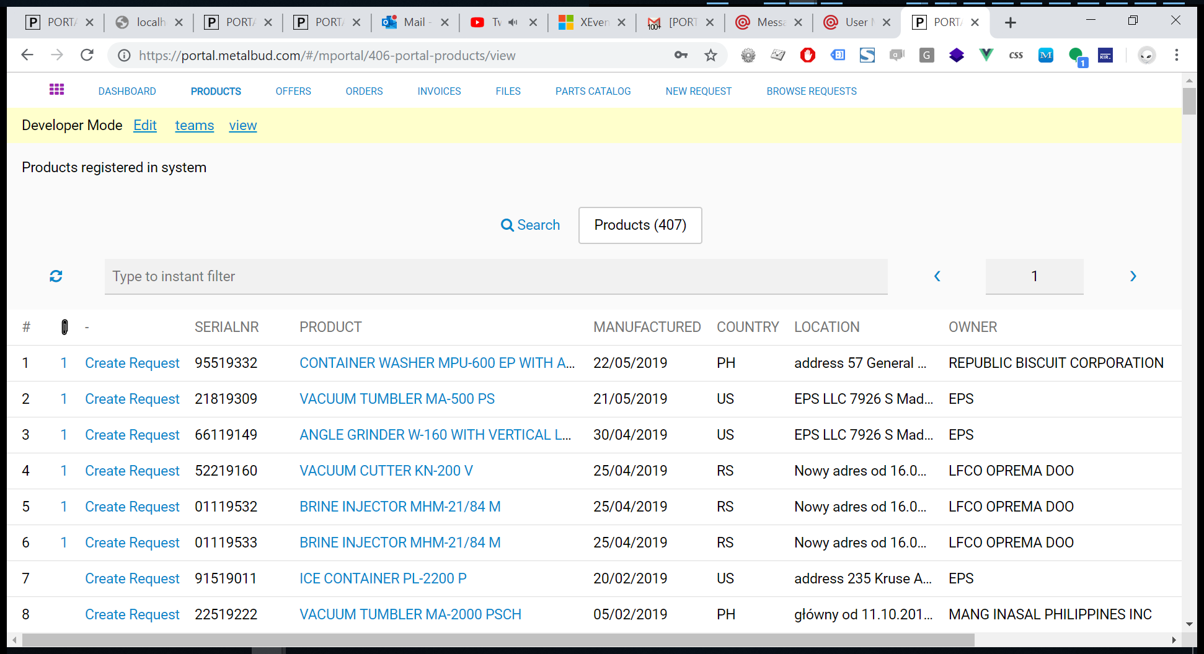

Slide 18
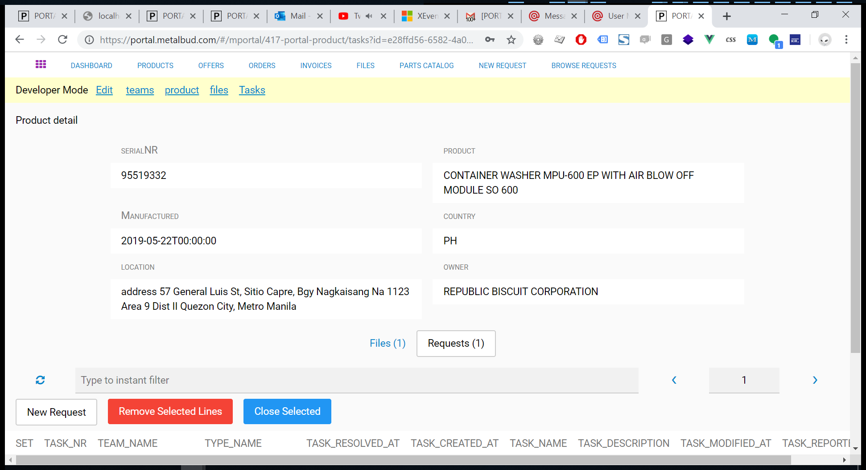

Slide 19
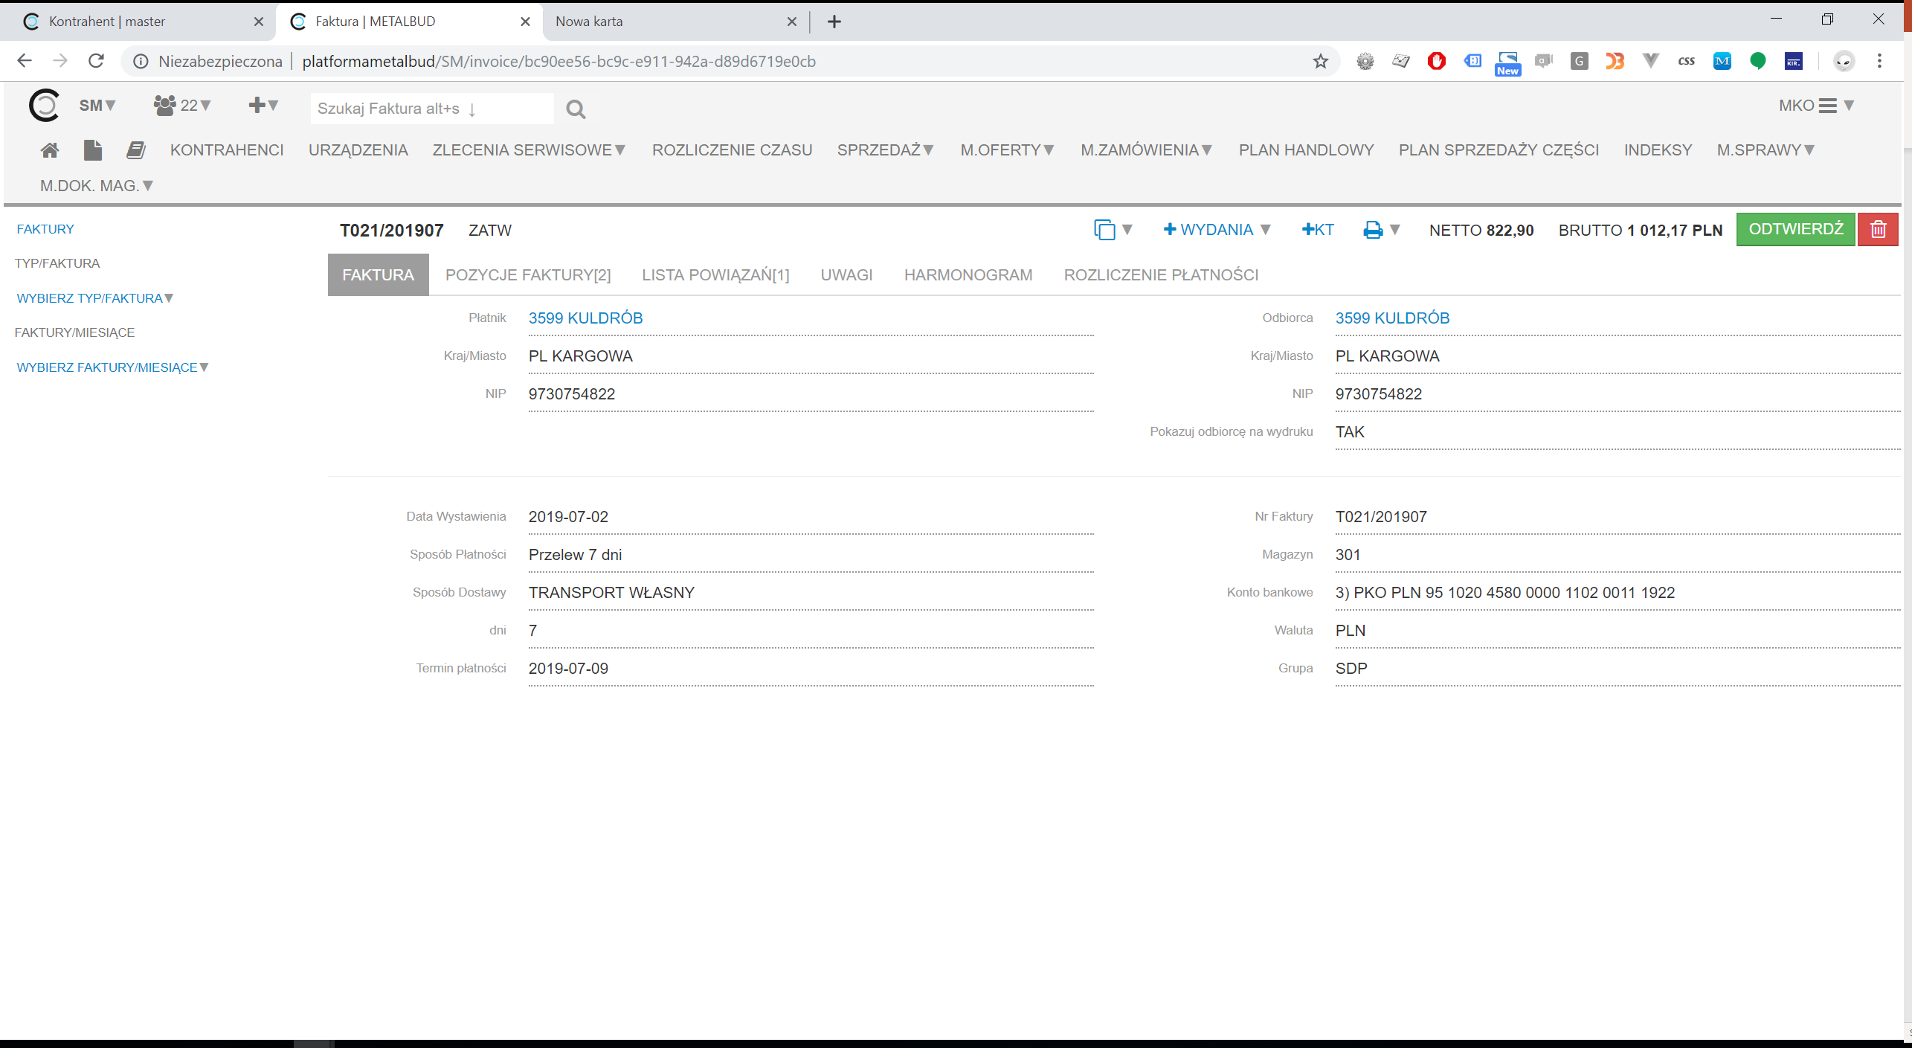

Slide 20
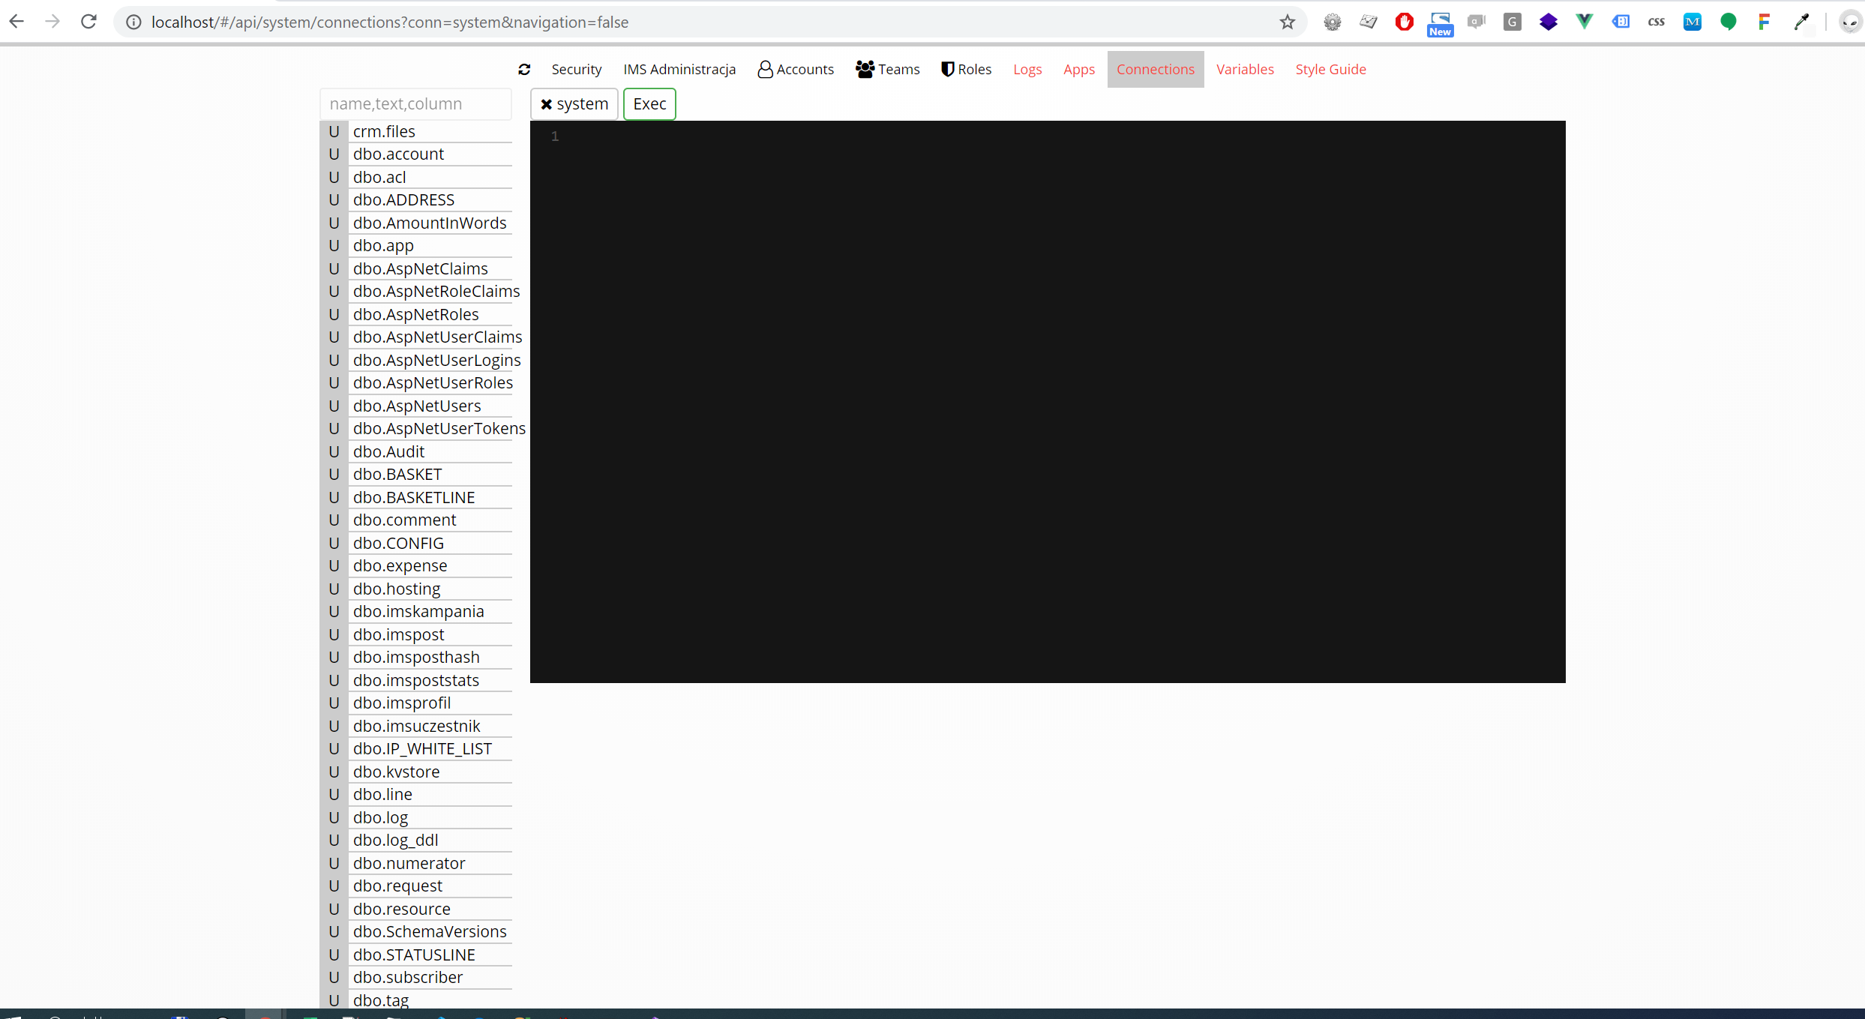

Slide 21
Nawigacja

Slide 22
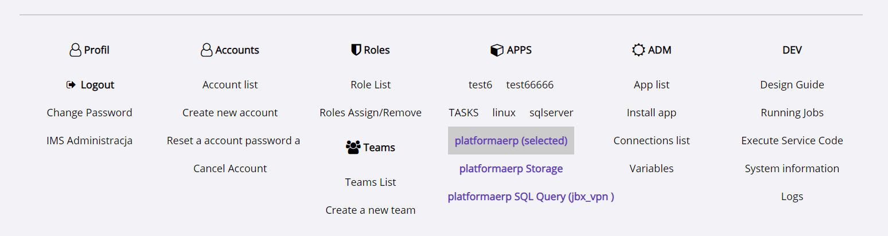
before

Slide 23
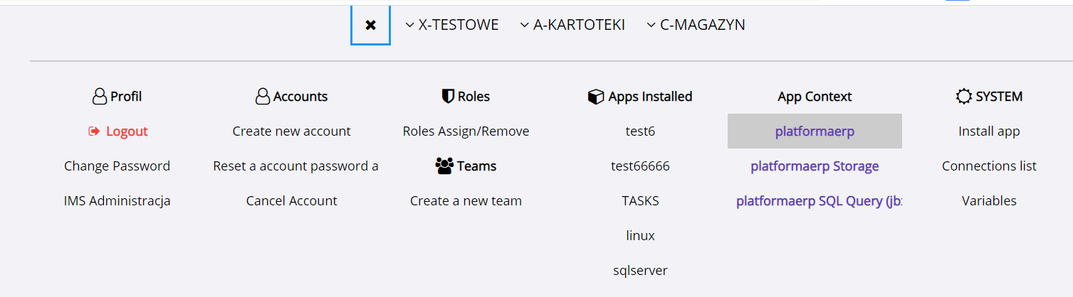
After 202013

Slide 24
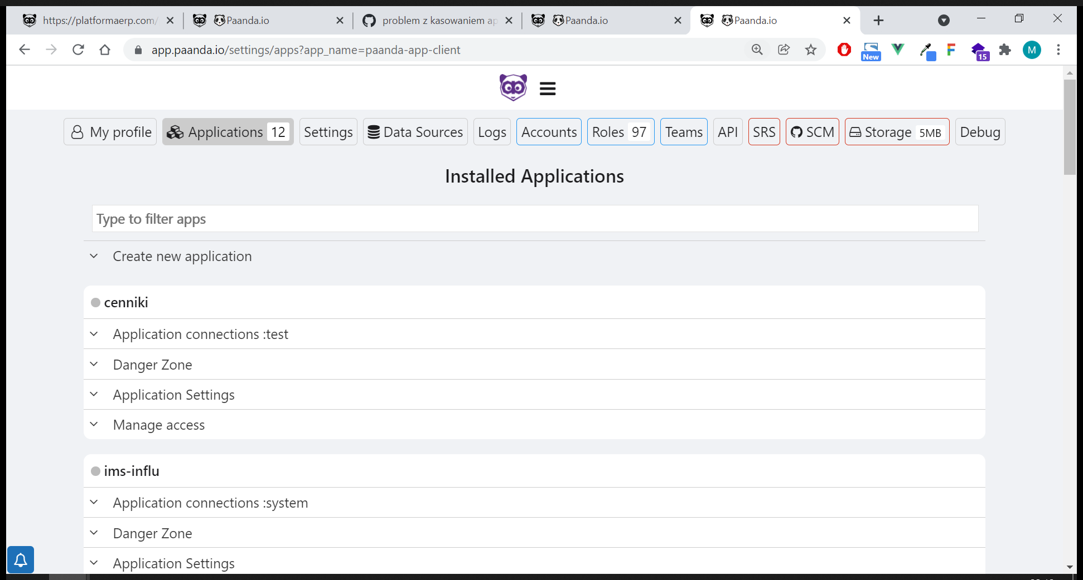
Before aplikacje

Slide 25
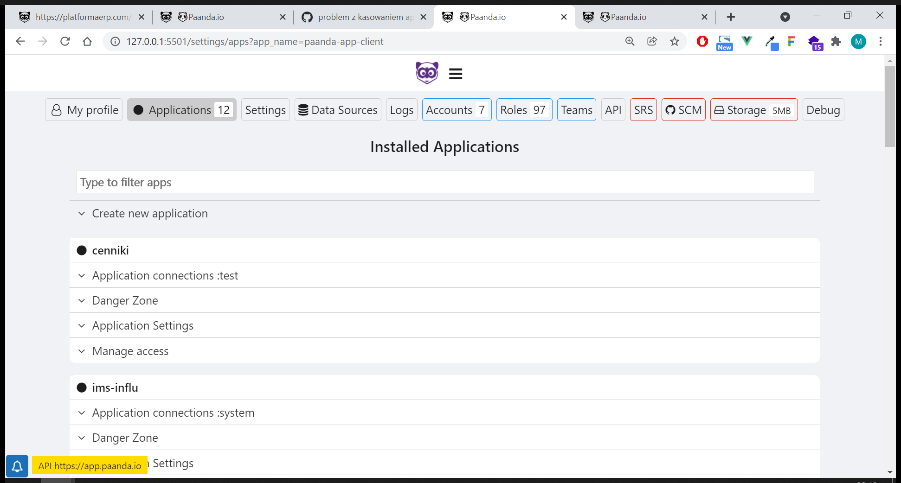
after aplikacje

Slide 26
GRID

Slide 27
